Slide 1

Lecture 10
Summary & Project

Slide 2

Agenda
JS101 Summary
Project

Slide 3
JS101 Summary

Slide 4

What have we learnt so far?
Command Line
Java Script
Variables, List/Array, Object
Conditions and Conditional Statements
Loops
User Input

Slide 5
How we construct a program from what we learnt?
Code Editor (VSCode, Eclipse, Jetbrains Series etc)
Edit
Programs (your assignments, projects, Microsoft Word etc)
Build with
Programming Languages
(e.g. Java Script, Python, Java etc)
Built-in Libraries
(e.g. readline)
Open Source and 3rd Party Libraries
(e.g. prompt-sync)
Package Manager
(e.g. npm)
included
Syntax
(e.g. if, for, while)
Built-in Features
(Array, Object, regex etc)
managed by

Slide 6
Project - Tic Tac Toe

Slide 7

Wrap-up Project
Tic Tac Toe

Slide 8
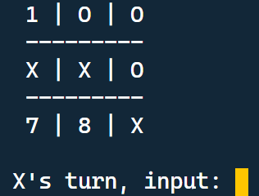
Project 1 - Tic Tac Toe
inside a Console...

Slide 9
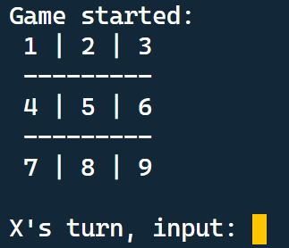
Project - Tic Tac Toe
Get the user input through Command Line
User input a number
from 1 to 9

Slide 10
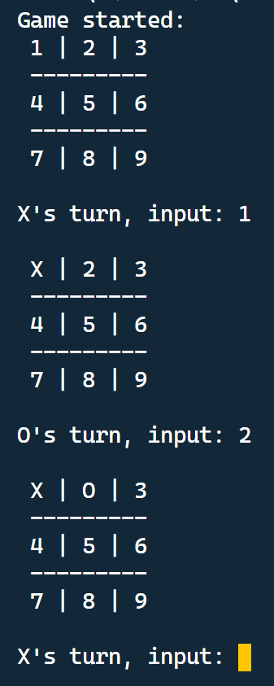


Basic Rules
X
Player X starts first
Players X and O take turn
inputting their position
O
X

Slide 11
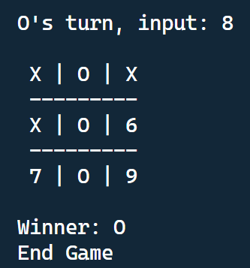
Basic Rules
Check Winner after every moves

Slide 12

Basic Rules
The player who succeeds in placing three of their marks in a vertical, horizontal or diagonal row wins the game.

